Slide 1

MOBILE APPS USING ANDROID
ANDROID PREFERNCE AND DATA STORAGE

Slide 2

ANDROID- DATA STORAGE OPTIONS
• Android provides several options for you to save persistent application data
• The solution you choose depends on your specific needs, such as
> whether the data should be private to your
application or accessible to other applications
(and the user)
> how much space your data requires.

Slide 3
DATA STORAGE OPTIONS
• Shared preferences
> Store private primitive data in key-value pairs
• Internal storage
> Store private data on the device memory
• External storage
> Store public data on the shared external storage
• SQLite databases
> Store structured data in a private database
• Network connection
> Store data on the web with your own network server

Slide 4
CONTENT PROVIDER & DATA STORAGE
Most content providers store their data using Android's file storage methods or SQLite databases, but you can store your data any way you want.

Slide 5
WHEN TO USE SHARED PREFERENCES?
The Shared Preferences class provides a general framework that allows you to save and retrieve persistent key-value pairs of primitive data types.
• You can use Shared Preferences to save any primitive data:
> booleans, floats, ints, longs, and strings.
• This data will persist across user sessions (even if your application is killed)
PreferenceActivity Class
If you're interested in creating user preferences for your application, see PreferenceActivity, which provides an Activity framework for you to create user preferences, which will be automatically persisted (using shared preferences underneath)

Slide 6
HOW TO USE SHARED PREFERENCES?
To get a Shared Preferences object for your application, use one of two methods:
getSharedPreferences() - Use this if you need multiple preferences files identified by name, which you specify with the first parameter.
getPreferences() - Use this if you need only one preferences file for your Activity. Because this will be the only preferences file for your Activity, you don't supply a name.
To write values:
Call edit() to get a SharedPreferences.Editor
Add values with methods such as putBoolean() and putString()
Commit the new values with commit()
To read values:
use SharedPreferences methods such as getBoolean() and getString()

Slide 7
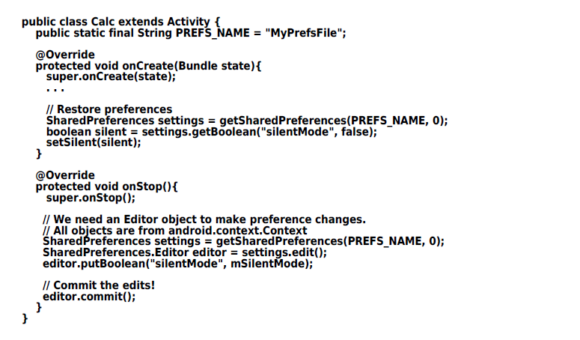
EXAMPLE: USING SHARED PREFERENCES

Slide 8
INTERNAL STORAGE
You can save files directly on the device's internal storage.
• By default, files saved to the internal storage are private to your application and other applications cannot access them
• When the user uninstalls your application, these files are removed.
To create and write a private file to the internal storage:
Call openFileOutput() with the name of the file and the operating mode. This returns a FileOutputStream object
Write to the file with write()
Close the stream with close()
• To read a file from internal storage
Call openFileInput() and pass it the name of the file to read. This returns a FileInputStream.
Read bytes from the file with read()
Then close the stream with close()

Slide 9
INTERNAL STORAGE – Other useful methods
• getFilesDir()
> Gets the absolute path to the filesystem directory
where your internal files are saved.
• getDir()
> Creates (or opens an existing) directory within your
internal storage space.
• deleteFile()
> Deletes a file saved on the internal storage.
• fileList()
> Returns an array of files currently saved by your
application.
Example: Using Internal Storage
String FILENAME = "hello_file";
String string = "hello world!";
FileOutputStream fos = openFileOutput(FILENAME, Context.MODE_PRIVATE);
fos.write(string.getBytes());
fos.close();

Slide 10
EXTERNAL STORAGE
Every Android-compatible device supports a shared "external storage" that you can use to save files
This can be a removable storage media (such as an SD card) or an internal (non-removable) storage
Files saved to the external storage are world readable and can be modified by the user when they enable USB mass storage to transfer files on a computer
Checking Media Availability:
Before you do any work with the external storage, you should always call getExternalStorageState() to check the state of the media
Mounted
Missing
Read-only
Some other stat

Slide 11
EXTERNAL STORAGE - ACCESSING FILES
If you're using API Level 8 or greater, use getExternalFilesDir() to open a File that represents the external storage directory where you should save your files
This method takes a type parameter that specifies the type of subdirectory you want, such as DIRECTORY_MUSIC and DIRECTORY_RINGTONES
This method will create the appropriate directory if necessary.
By specifying the type of directory, you ensure that the Android's media scanner will properly categorize your files in the system (for example, ringtones are identified as ringtones and not music)
If the user uninstalls your application, this directory and all its contents will be deleted.
If you're using API Level 7 or lower, use getExternalStorageDirectory(), to open a File representing the root of the external storage. You should then write your data in the following directory: > /Android/data/<package_name>/files/
(where <package_name> is your Java-style package name, such as "com.example.android.app")

Slide 12
SAVING FILES THAT SHOULD BE SHARED
If you want to save files that are not specific to your application and that should not be deleted when your application is uninstalled, save them to one of the public directories on the external storage.
These directories lay at the root of the external storage, such as Music/, Pictures/, Ringtones/, and others.
In API Level 8 or greater
Use getExternalStoragePublicDirectory(), passing it the type of public directory you want, such as DIRECTORY_MUSIC, DIRECTORY_PICTURES, DIRECTORY_RINGTONES, or others.
This method will create the appropriate directory if necessary.
In API Level 7 or lower
Use getExternalStorageDirectory() to open a File that represents the root of the external storage, then save your shared files in one of the following directories:
Music/, Podcasts/, Ringtones/, Alarms/, Notifications/, Pictures/, Movies/, Download/

Slide 13
USING DATABASES
Android provides full support for SQLite databases.
SQLite is a software library that implements a selfcontained, serverless, zero-configuration, transactional SQL database engine.
Any databases you create will be accessible to any class in the application, but not outside the application.
The recommended method to create a new SQLite database is to create a subclass of SQLiteOpenHelper and override the onCreate() method, in which you can execute a SQLite command to create tables in the database

Slide 14
USING DATABASES – TWO OPTIONS
Option #1
The recommended method to create a new SQLite database is to create a subclass of SQLiteOpenHelper and override the onCreate() method, in which you can execute a SQLite command to create tables in the database.
Then use execSQL() for executing SQL
Option #2
Use openOrCreateDatabase() to create SQLiteDatabase
Then use execSQL() for executing SQ

